Slide 1
Daikin Visit
November 7, 2014

Slide 2
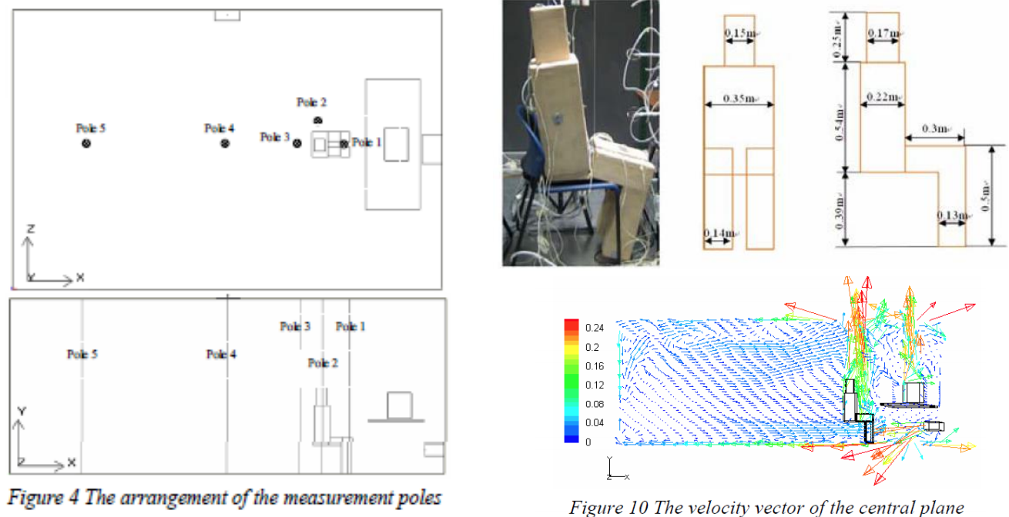
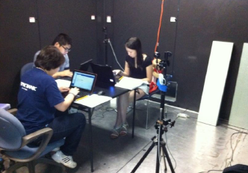
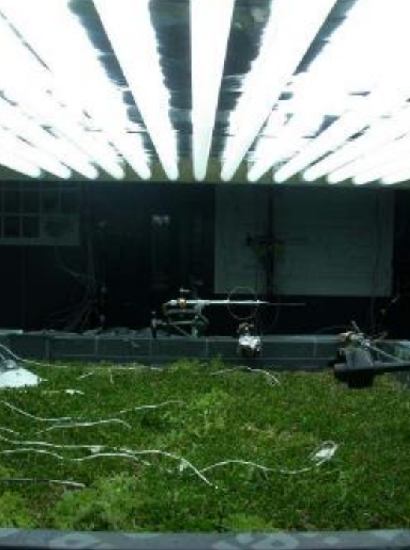
Completed Research
Intervention Thermal Comfort
Airflow Measurements
Green Roof Experiment
Testing Building Materials
Testing Airflow Supplies
Indoor Air Quality
Notes:
Previous Research

Slide 3
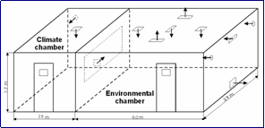
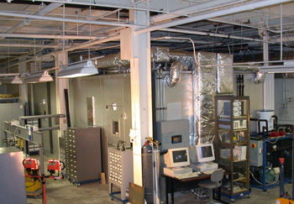
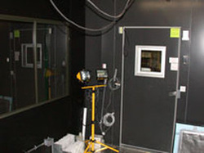
Reference Facility
Built and used over 12 years at Penn State
Climate Chamber simulates outdoor conditions
Environmental Chamber represents indoor spaces
Dual HVAC systems for separate chambers, independent controls
Measurement Instruments
Tracer Gas
Aero Trak
CO2 Sensors
P-Track
Temperature and Humidity Sensors
Notes:
Penn State Facilty

Slide 4
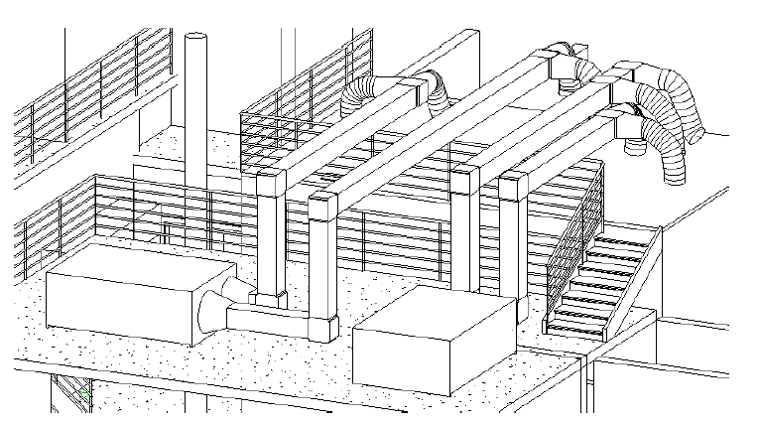
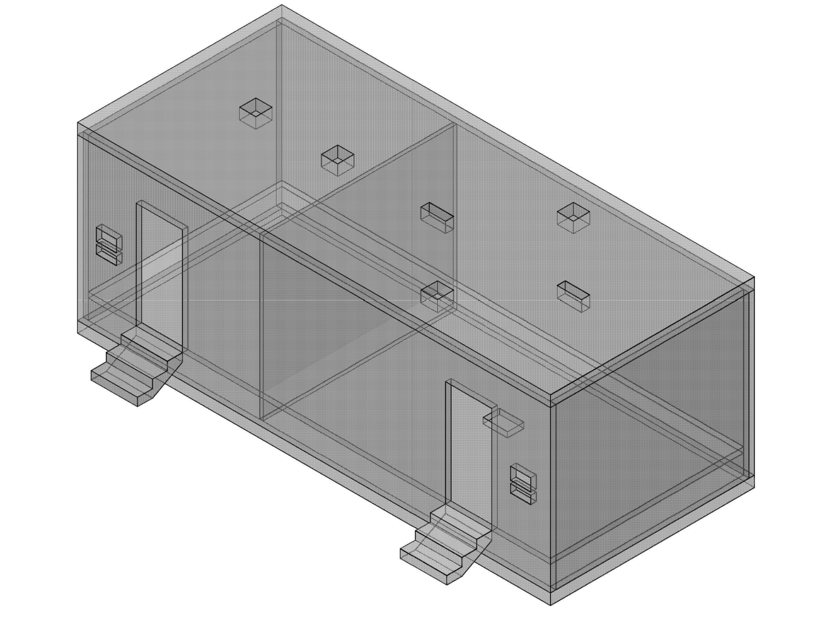
New Environmental Chamber
15’ x 22’ x 15’
Climate and Environmental Chambers
Notes:
Old Facility

Slide 5
New Environmental Chamber
Dual Compartments Testing Chamber
Controls
Max time to new set response is 10 min
Supply air change rate from 0.5 to 20 ACH
Record measurements in real time at varying intervals
Power Availability
208 3 Phase & 250 Amps
Max Supported Load is 2kW
6 People, 6 PCs, lamps, and testing equipment
Notes:
Old Facility

Slide 6
New Environmental Chamber
AHU Details
Independent Air Cooled AHUs
Operate with 0-100% of the outdoor air
Design for Outdoor Air (100% OA)
Summer 95ºF 60% RH
Winter 19.4ºF 60% RH
MERV 8 filtered blower VSD accurately supplies air for 0.5 air changes per hour
Notes:
Old Facility

Slide 7
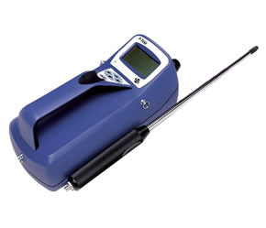
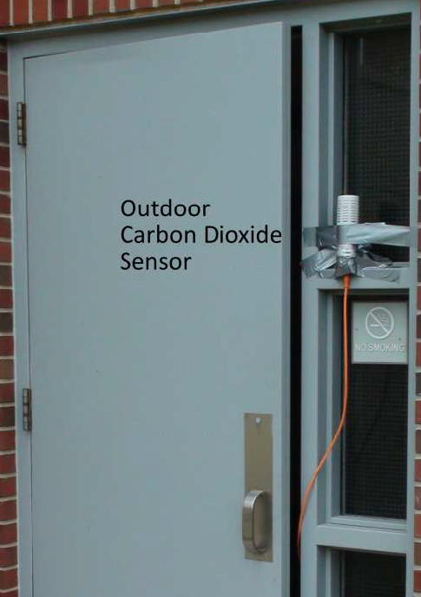
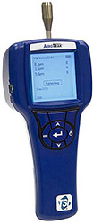
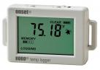
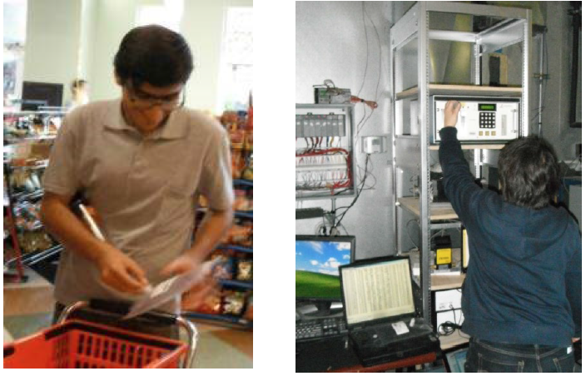
Measurement Capabilities
SF6 Tracer Gas
Portable Temperature iButtons
Handheld Aero-Trak
Handheld P-Trak
CO2 Sensors
Temperature and Humidity Sensors
Thermal Cameras
Notes:
Old Facility

Slide 8
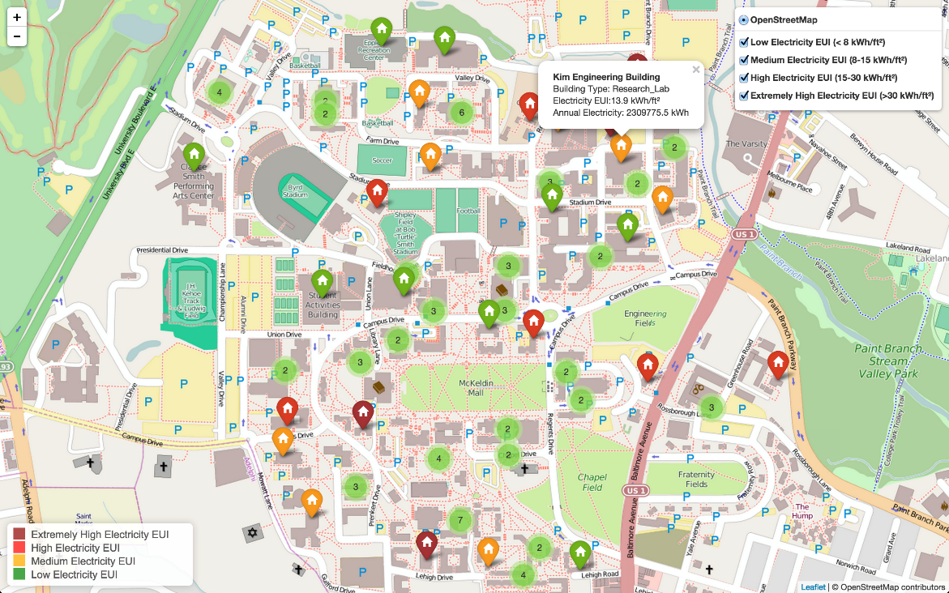

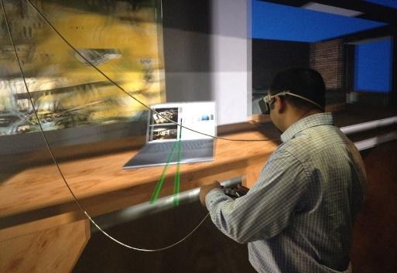
Ongoing& Future research
EFRI PULSE
Urban Modeling at Campus Level
Energy Modeling + CFD + Solar Radiation
Multi-Building Control Strategies
Relations to Occupant Comfort/Health
Smart Building Experience
Occupant feedback to building systems
Occupant physiological responses
Environmental Chamber tests
Real Time Energy & Occupant Visualiation
Notes:
Old Facility

